Slide 1


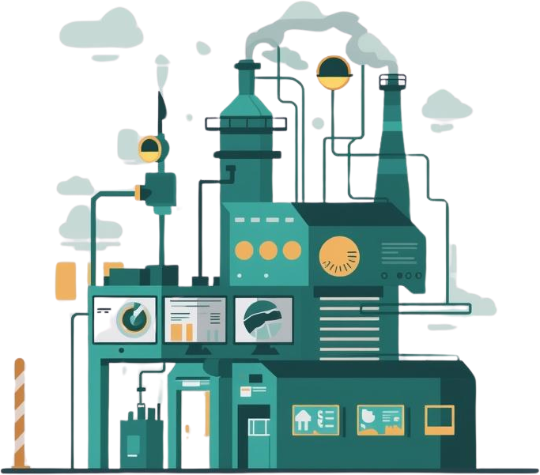
Smart Manufacturing Solutions
IoT in
Industrial Control
Transforming Modern Manufacturing Through Connected Systems
Presented to:
Technology Overview

Slide 2

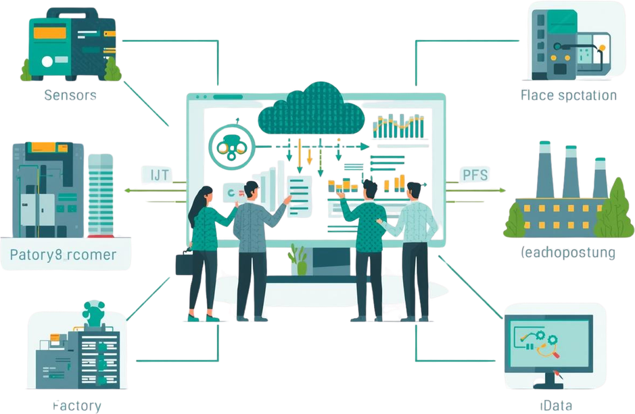
IoT & ICS
Fundamentals
The Internet of Things (IoT) refers to interconnected devices that collect and exchange data over networks. Industrial Control Systems (ICS) are specialized systems used to monitor and control industrial processes. The convergence of IoT and ICS creates smart industrial environments with enhanced monitoring, automation, and data-driven decision making capabilities.

Slide 3


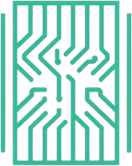


Core IoT-ICS Components
Sensors & Actuators
Controllers (PLCs/RTUs)
Industrial Networks
Cloud Platforms
Collect real-time data from industrial processes and execute physical actions.
Process data locally and manage automated control sequences.
Enable secure communication between devices and systems.
Store, analyze, and visualize industrial data remotely.

Slide 4
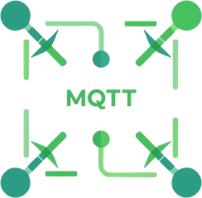

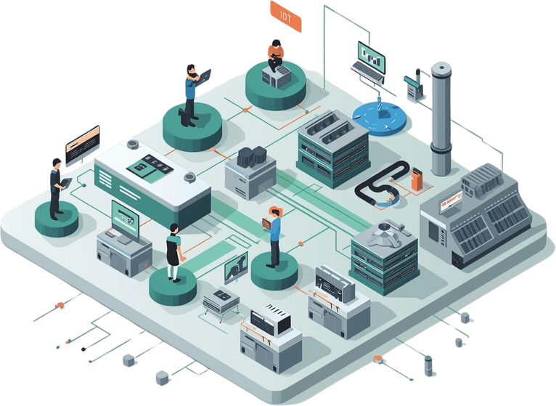



Communication
Protocols
MQTT Protocol
Lightweight publish-subscribe messaging for IoT devices.
OPC-UA
Secure machine-to-machine communication standard.
Modbus
Serial protocol for connecting industrial PLCs.
Ethernet/IP
Real-time industrial automation networking.

Slide 5





Data Collection
Process
IoT sensors continuously collect data from industrial equipment including temperature, pressure, vibration, and flow rates. This data is transmitted via industrial protocols like MQTT or OPC-UA to edge gateways, then forwarded to cloud platforms for processing and analysis.

Slide 6



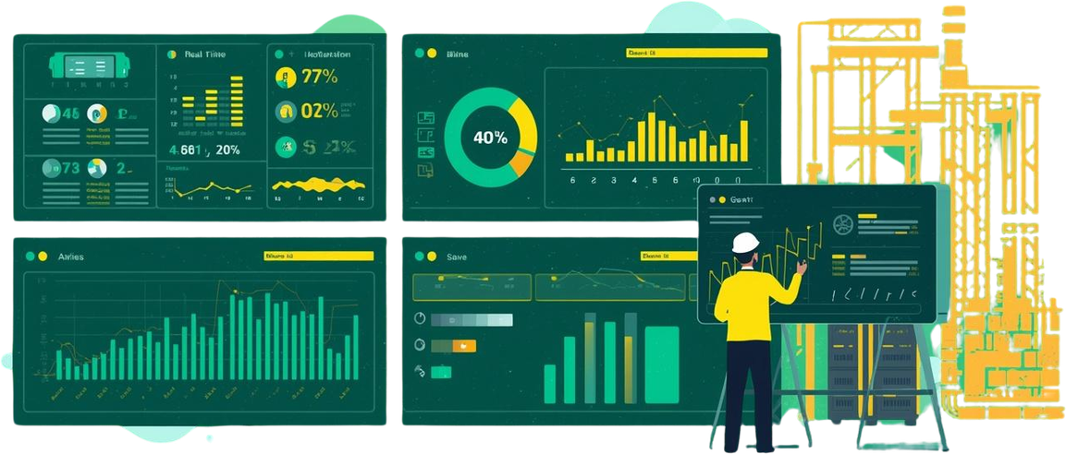
Real-Time Data
Analytics
IoT-enabled ICS leverages edge computing to process data locally, reducing latency from seconds to milliseconds. Real-time analytics enable predictive maintenance, anomaly detection, and instant decision-making at the factory floor level.

Slide 7




Key Benefits
Predictive Maintenance
Energy Efficiency
Quality Control
Cost Reduction
Reduce downtime by detecting equipment failures before they occur.
Optimize power consumption through smart monitoring and automation.
Real-time monitoring ensures consistent product standards.
Lower operational expenses through process optimization.

Slide 8
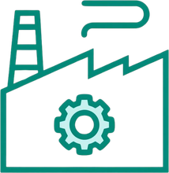

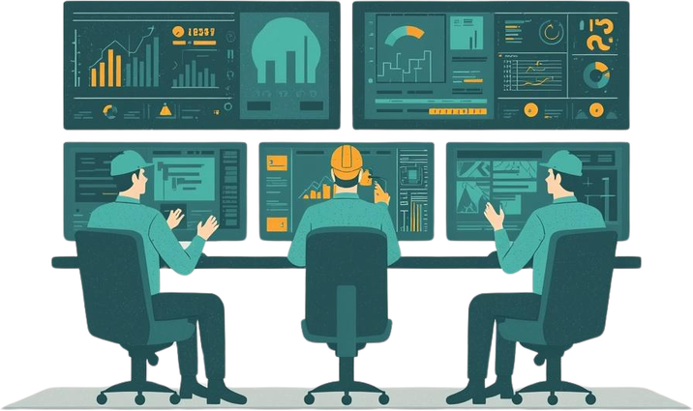



Industrial IoT
Applications
Manufacturing
Smart factories with automated production lines and quality control.
Oil & Gas
Pipeline monitoring, leak detection, and remote asset management.
Utilities
Smart grid management and energy distribution optimization.
Logistics
Fleet tracking, warehouse automation, and supply chain visibility.

Slide 9

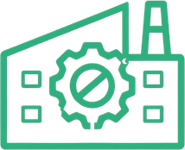
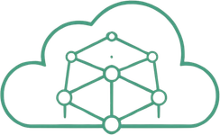
Traditional vs IoT
ICS Comparison
Traditional ICS relies on isolated networks with manual monitoring and limited data visibility. IoT-integrated ICS enables real-time analytics, predictive maintenance, and remote access, improving efficiency by 25-40% while reducing downtime by up to 50%.

Slide 10





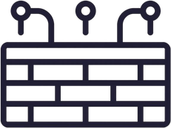
Security
Challenges
IoT-ICS integration introduces network vulnerabilities including unauthorized access, data breaches, and malware attacks. Mitigation strategies include network segmentation, encryption protocols, intrusion detection systems, and regular security audits to protect critical infrastructure.

Slide 11

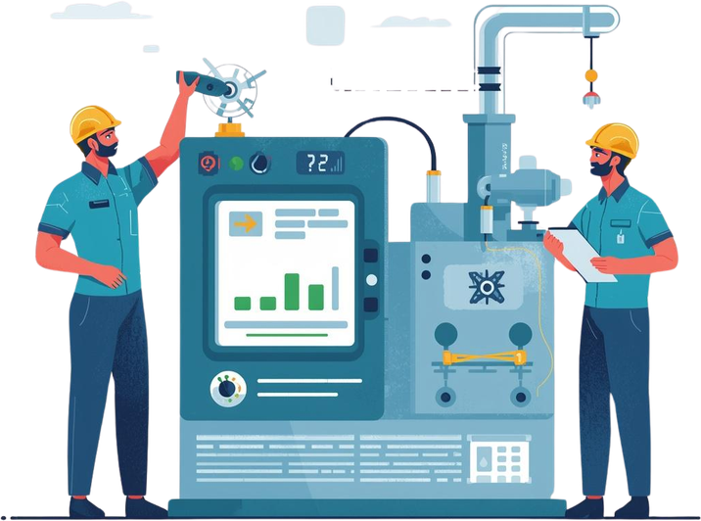
Implementation
Roadmap
Phase 1: Assess existing infrastructure and identify integration points. Phase 2: Deploy sensors and edge devices on critical equipment. Phase 3: Establish secure network connectivity and data pipelines. Phase 4: Integrate with SCADA/PLC systems. Phase 5: Launch monitoring dashboards and train personnel.

Slide 12


Case Study
Smart Factory Success
A leading automotive manufacturer implemented IoT sensors across their production line, connecting 500+ machines to a central monitoring system. Real-time data analytics enabled predictive maintenance and optimized workflows, resulting in a 40% efficiency improvement, 35% reduction in downtime, and $2.5M annual savings.

Slide 13

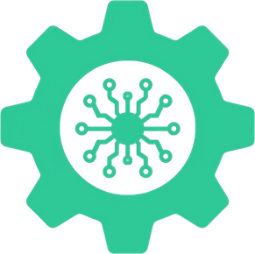
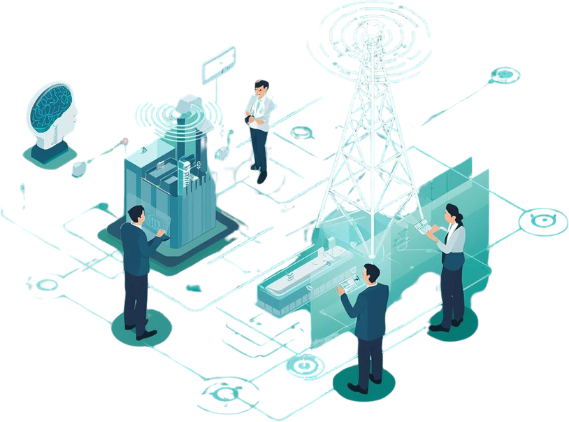

Emerging
Trends
The future of Industrial IoT is shaped by three transformative technologies: AI integration enables predictive analytics and autonomous decision-making. Digital Twins create virtual replicas for simulation and optimization. 5G connectivity delivers ultra-low latency and massive device support for real-time control.

Slide 14




Key Takeaways
IoT is revolutionizing industrial control systems by enabling real-time monitoring, predictive maintenance, and seamless automation. Through connected sensors, edge computing, and data analytics, manufacturers achieve unprecedented efficiency, reduced downtime, and smarter decision-making across operations.

Slide 15




Industrial IoT Solutions
Thank
You
Questions? Let's discuss Industrial IoT
www.industrialiot.com

